Slide 1

cse 101 arduıno Project
Group 5

Slide 2
Description
Materials used
Hardware part of the system
Software part of the system
Demonstration video
Team Members
TFW
Contents

Slide 3
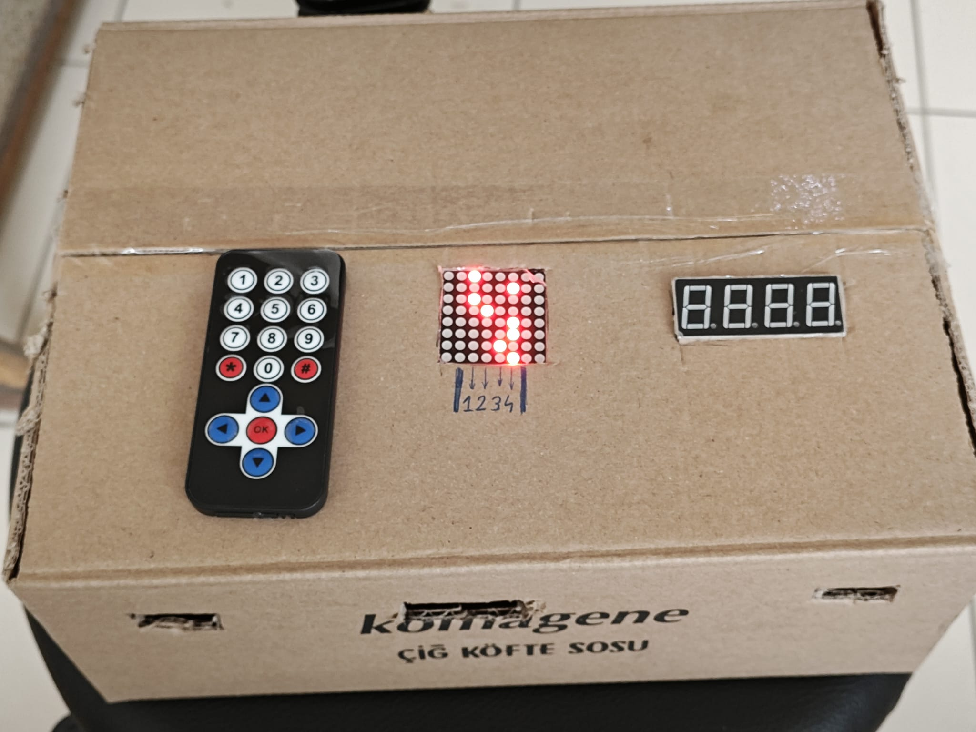
WHAT IS OUR PROJECT
A mind game that asks the player to memorize and draw the path with the dots given by arduino.

Slide 4
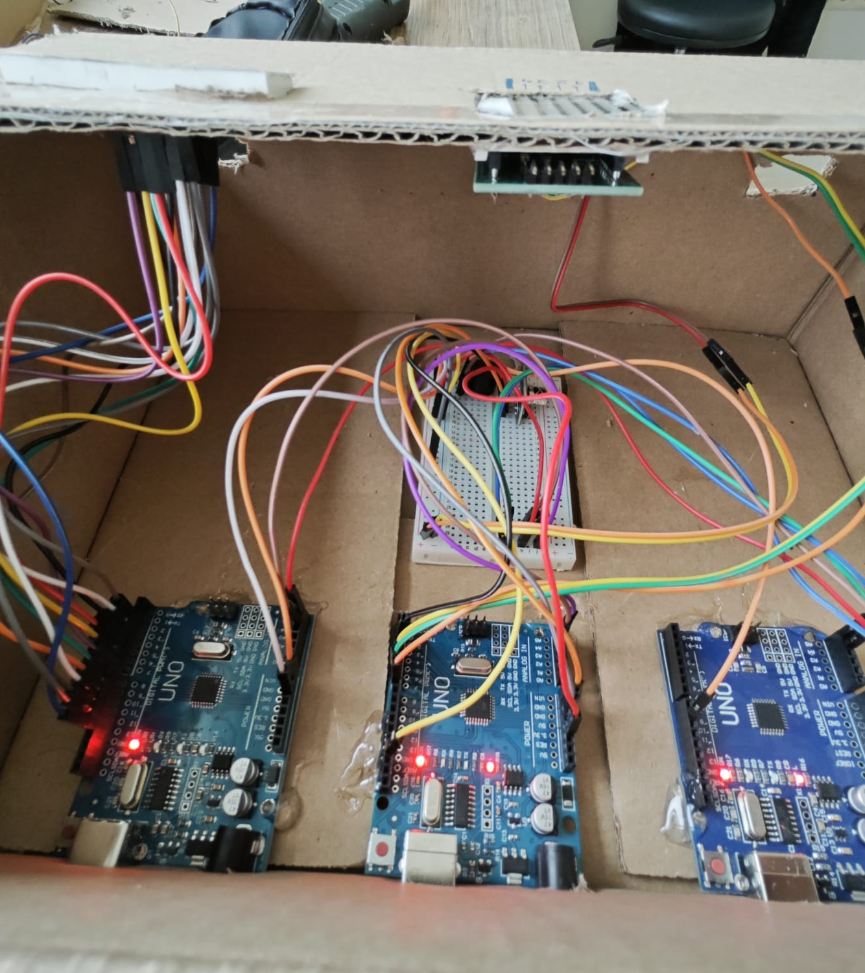
3 Arduino Uno
Remote controller
Breadboard
8x8 Dot matrix display
Battery
Buzzer
Jumper cables
7 segment LED display
USB-A to USB-B cable
Materıals lıst

Slide 5
HARDWARE OF THE PROJECT

Slide 6
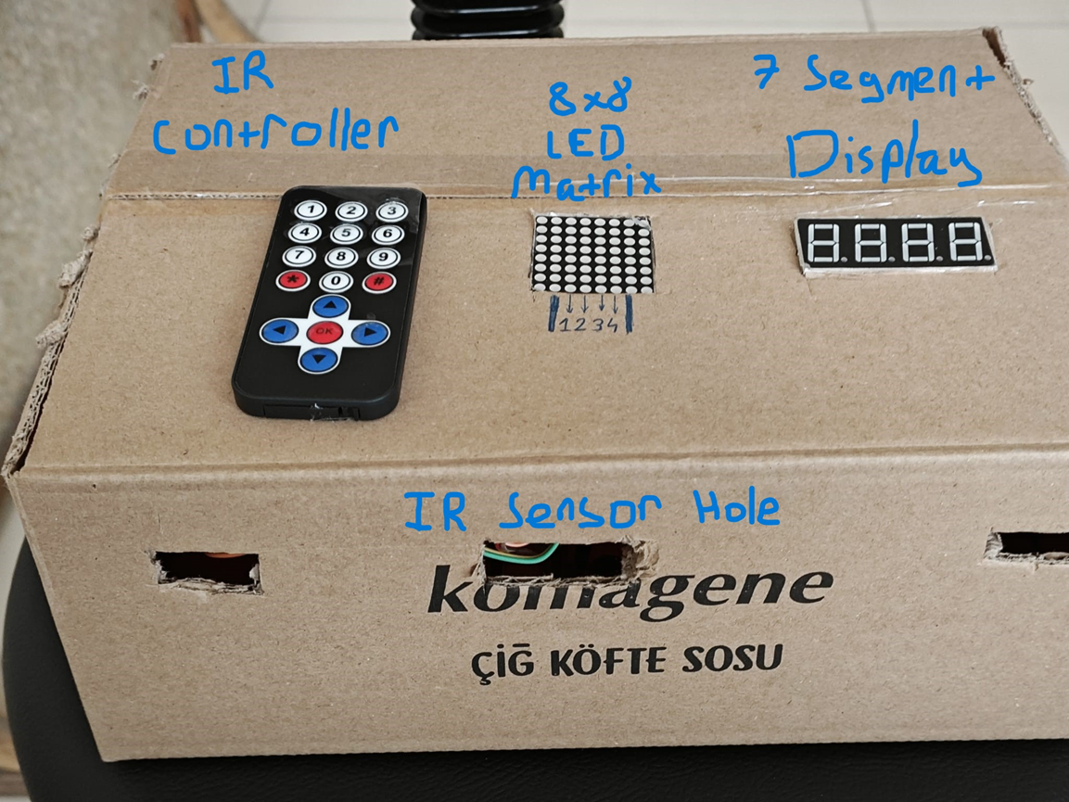
OUTLOOK OF THE BOX

Slide 7
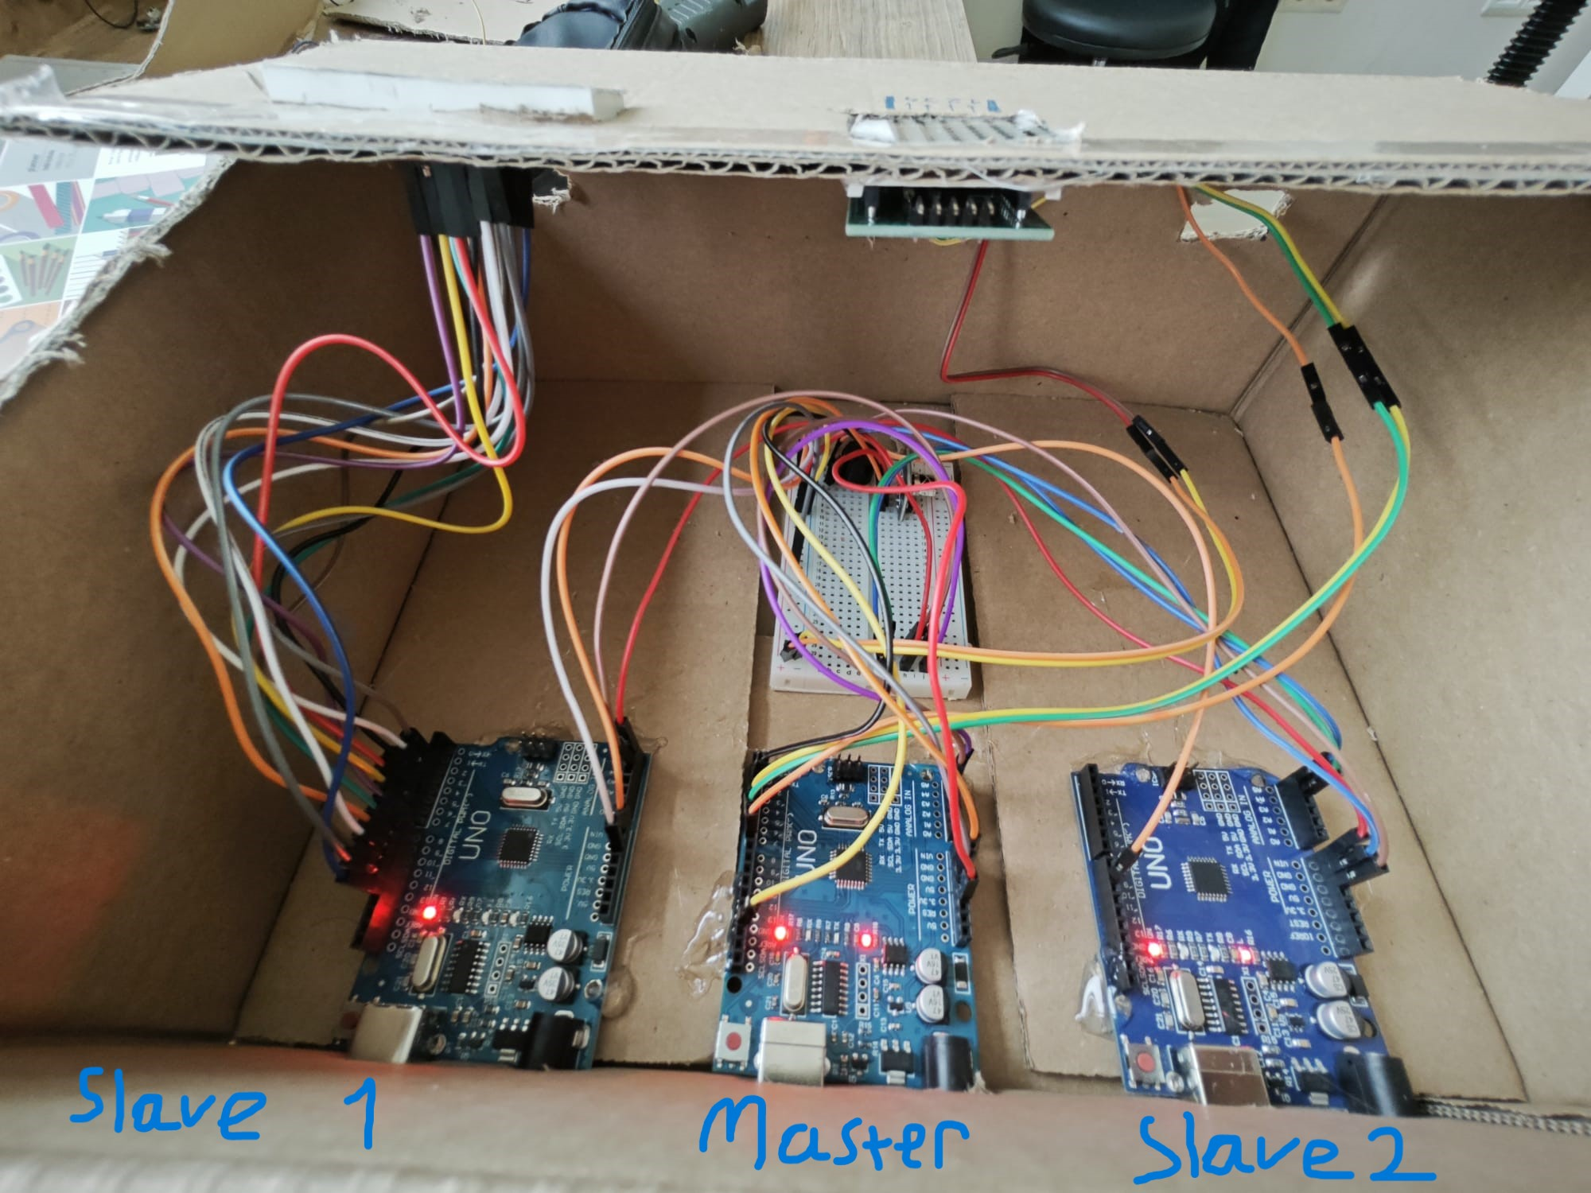
HOW IT LOOKS FROM INSIDE

Slide 8
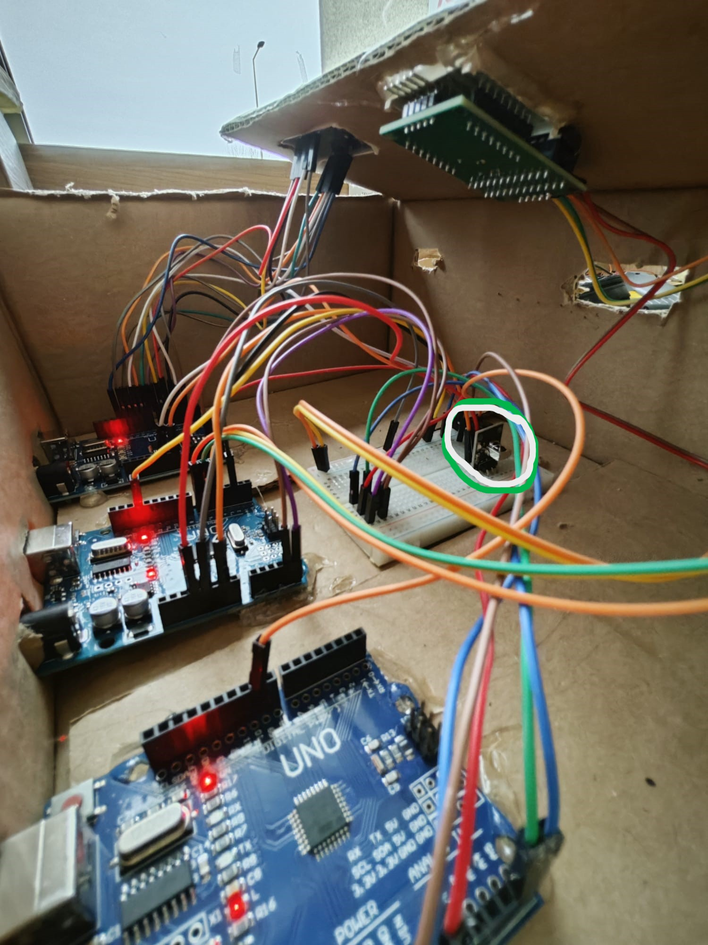
IR SENSOR

Slide 9
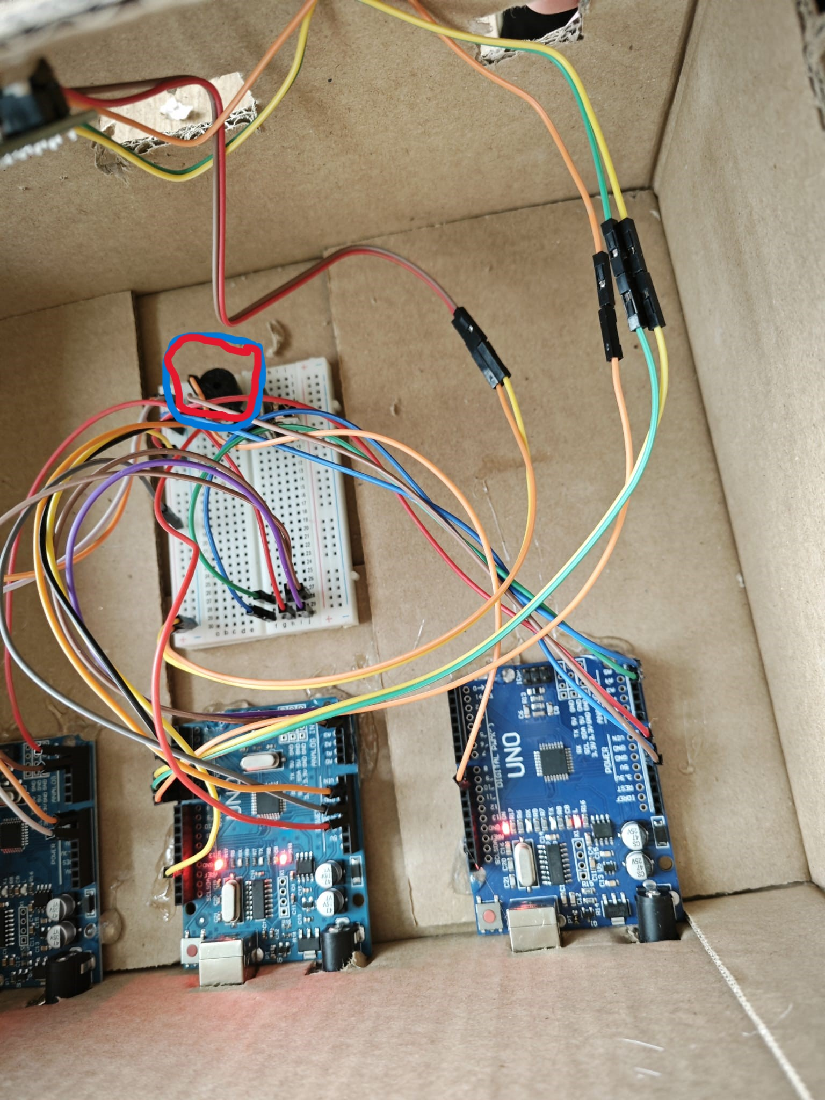
BUZZEr

Slide 10
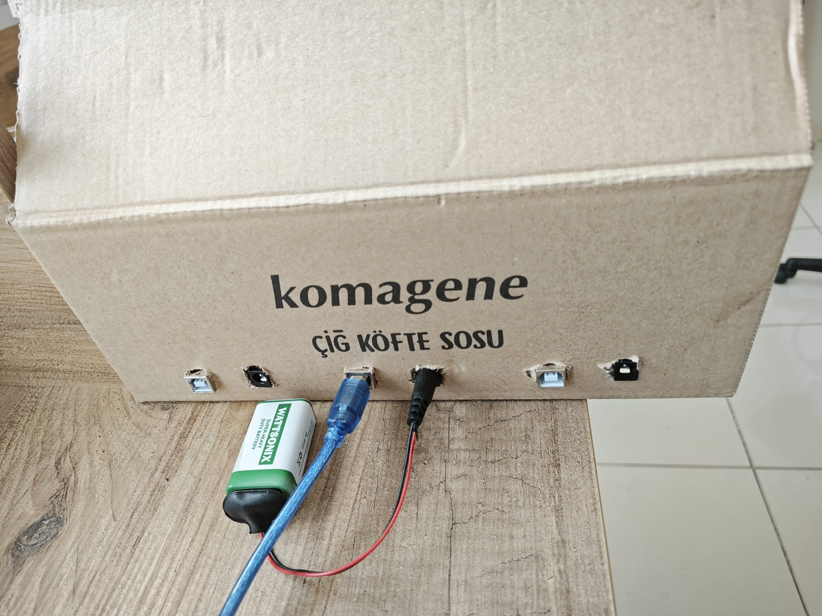
HOW IT LOOKS FROM BACK

Slide 11
SOFTWARE OF THE PROJECT
- C code for menu and level choosing
- Arduino code for game

Slide 12
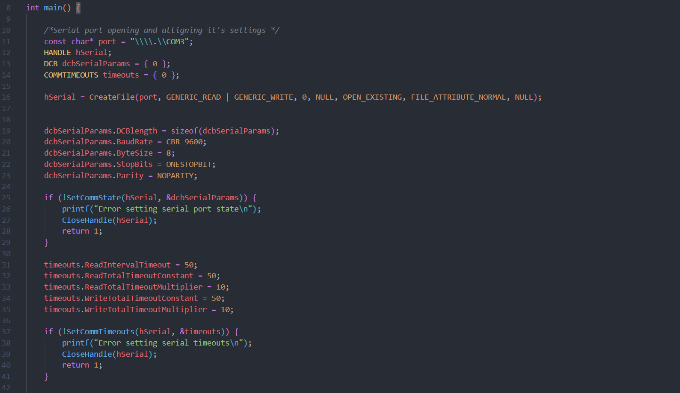
C CODE
Serial port opening and it’s settings

Slide 13
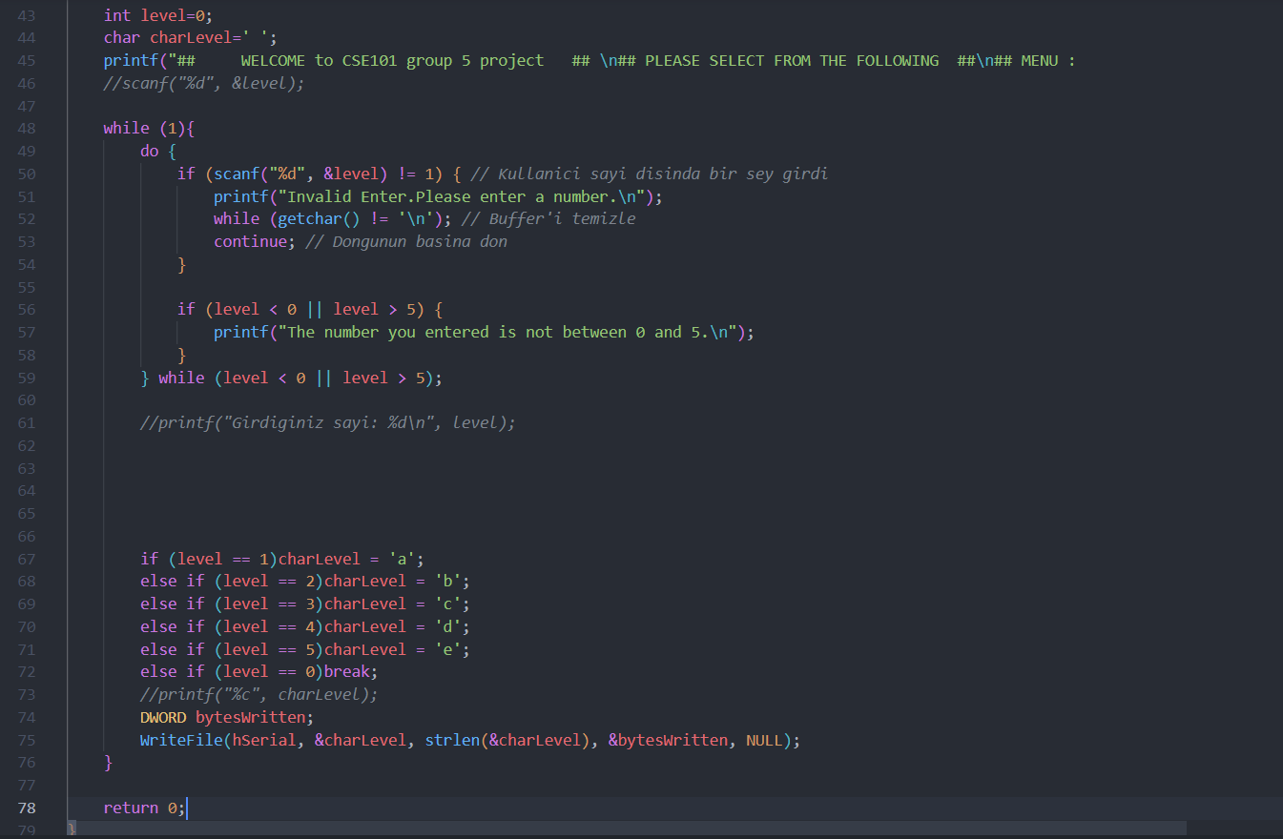
Choosing level and sending it to Arduino

Slide 14
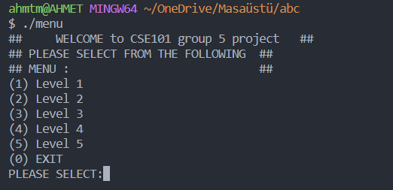

Slide 15
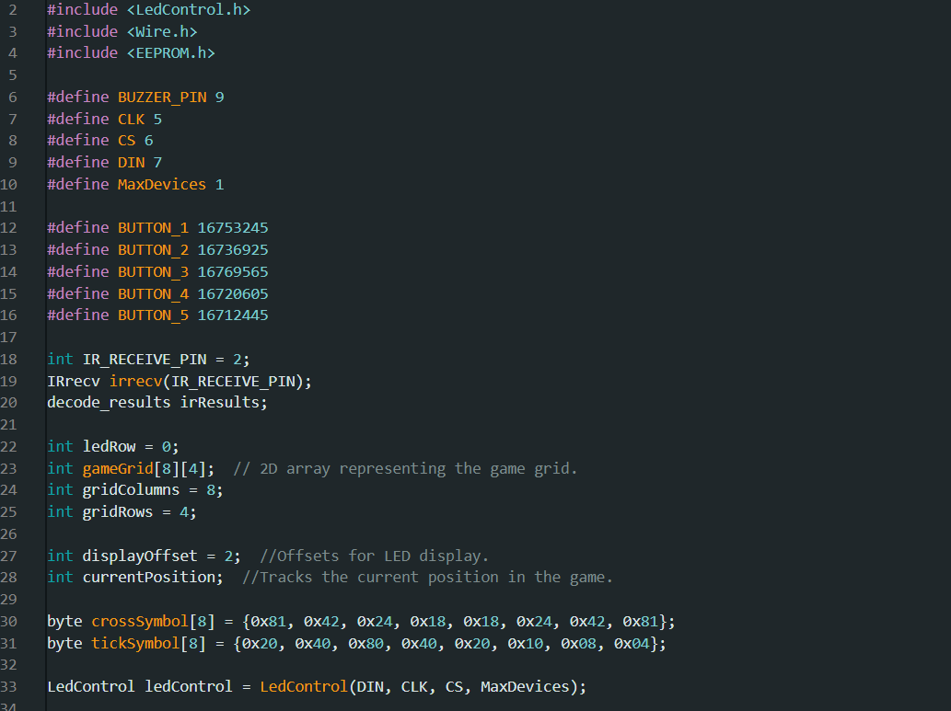
Arduino Code (CPP)
Global variables,libraries and settings

Slide 16
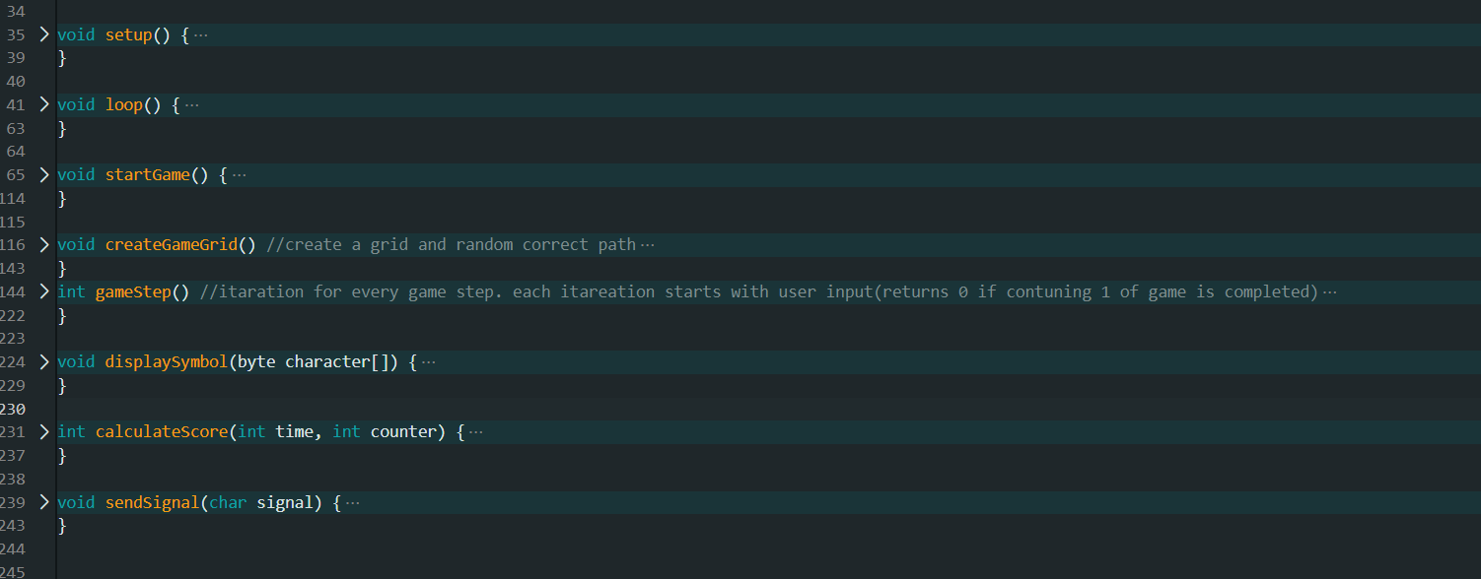
All Functions That We Created

Slide 17
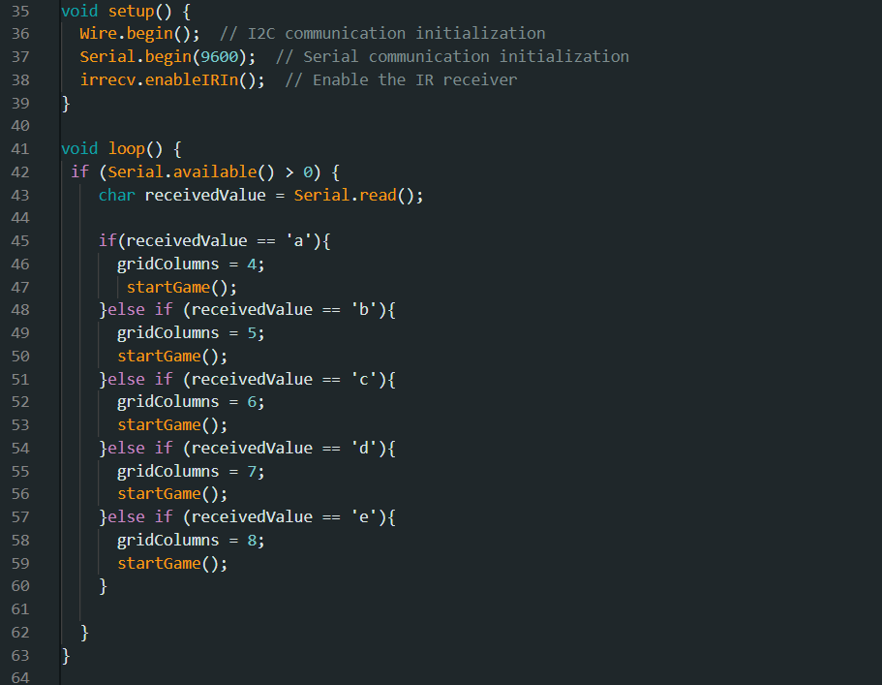
Setup And Loop

Slide 18
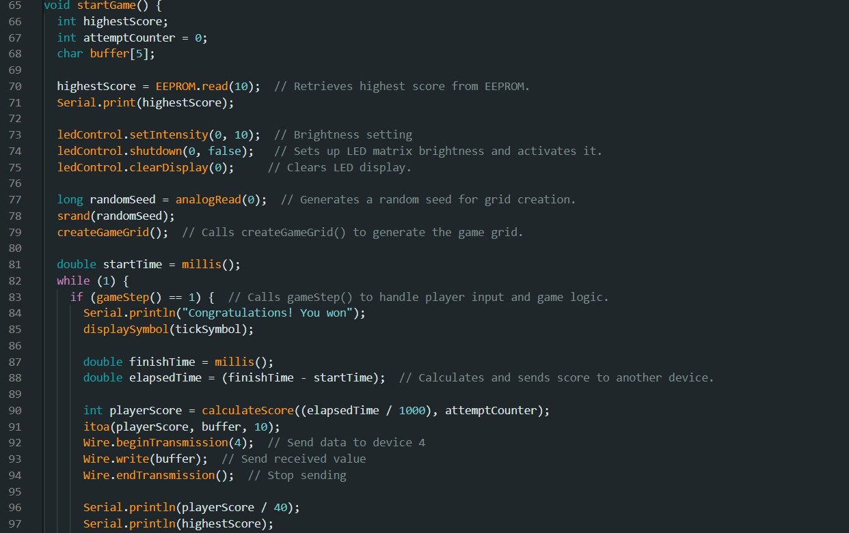
Let’s Start Game

Slide 19
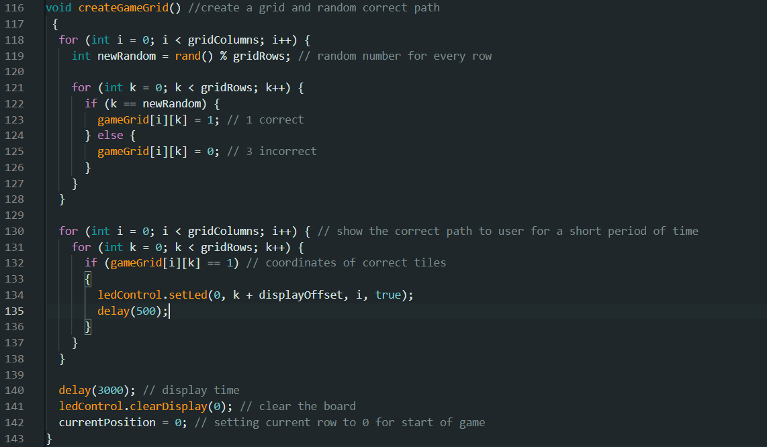
Creating randomized true answers

Slide 20
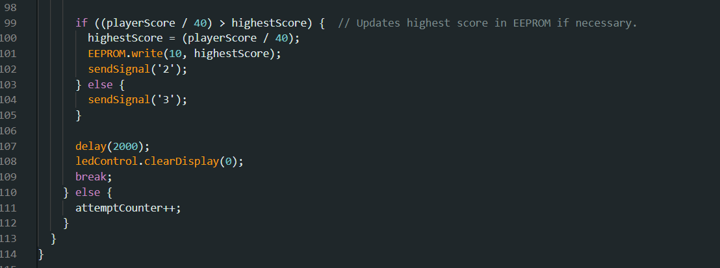
Let’s start the clock and actual game begins

Slide 21
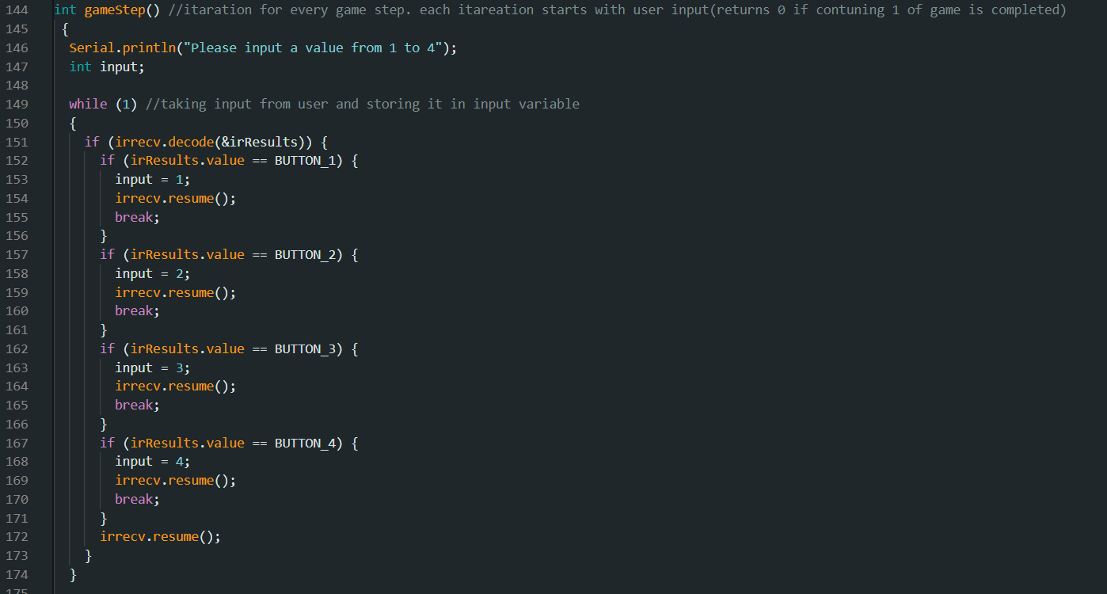
Game step() : Asking an input from user then checks whether it’s true

Slide 22
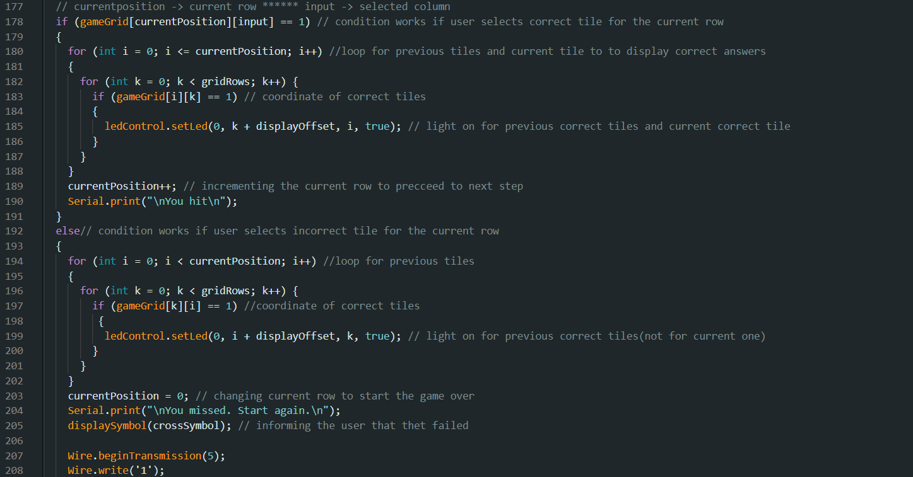
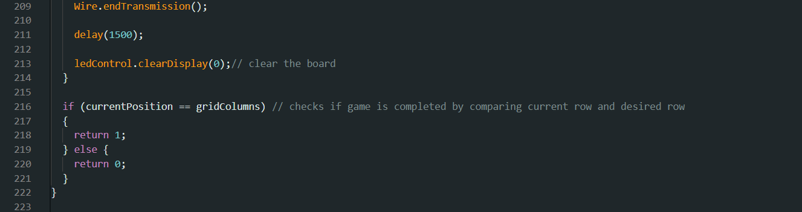

Slide 23
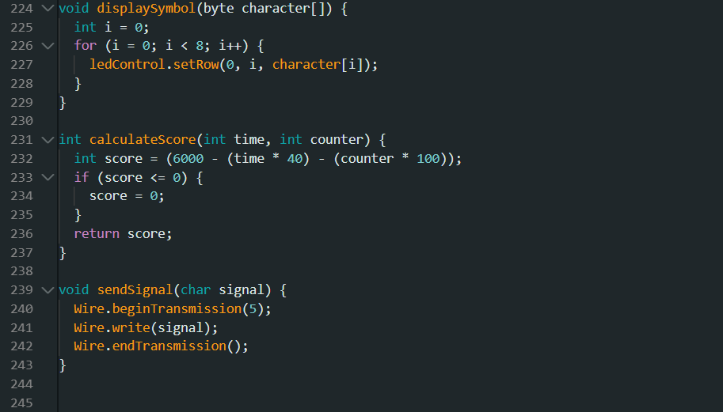

Slide 24
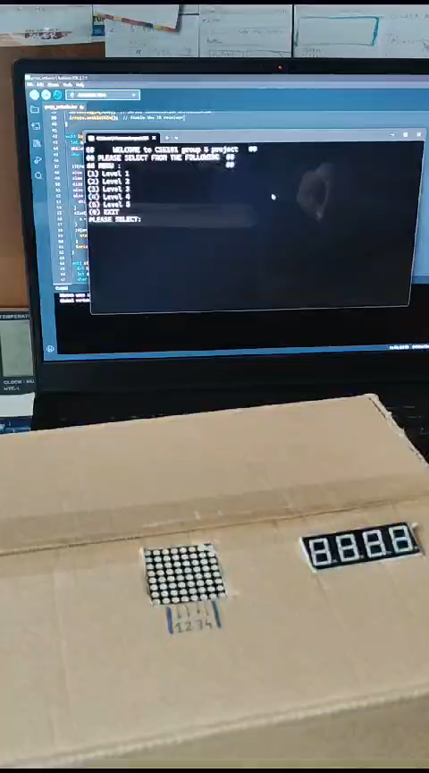

Slide 25
TEAM MEMBERS
- ALP ENES SEKER
- RUYA KOCAK
- KERIM ALP OZKAN
- ALPEREN SOYLEN
- BEKIR GOKTEPE
- BERKANT CORA
- AHMET EMRE KURT
- MURAT TAS
- ZEYNEP SUDE TURAN

Slide 26
THANKS FOR WATCHING. If you have any questıons please ask!

